Slide 1
Rally Health Eligibility Canonical Update
Team Mackers
Notes:
Tony

Slide 2




Introduction
Tony Cai
University of Minnesota
Kristen Hawken
Iowa State
Naren Nandyal
University of Minnesota
Mason Schmidt
Pensacola Christian College
Notes:
Tony
Standard Assets Engineering Operations
"We partner with Optum data producers and consumers, along with Enterprise Data Architects, to design and implement standard data stores that make the most critical Optum data available to all parts of the business in a common, well understood form.”

Slide 3




Problem Statement
Background:
V2: the old way of constructing canonical streams
Costly
Risky
V3: current way of constructing canonical streams
Simplify transition
V2
V3
Rally Health
Notes:
Tony
Rally Health provides reward programs for customers of uhg
Currently check eligibilities through v2 stream
bad, because of high risk and high cost from limited knowledge, support, and outdated technologies
our project is updating Rally Health from V2 canonical streams to V3, therefore reducing cost and risk for us without Rally Health noticing a difference.
Rally will Consume same message, feel no effects. Not impacting consumer

Slide 4



How will we achieve this goal?
Using two different types of testing
Utilizing EBaaS to map the V3 canonical to the Rally schema
Using testing to make sure the mapping is done correctly
Unit testing – for specific mapped values
Using the EBaaS test harness – for testing all the mapped values
Notes:
Tony
Use EBaaS test harness and mapper to map v3 canonical scehmas to Rally schema
Like any software, it requires testing. However, testing for things like mapping is not as straight forward as just running a program and seeing if there are errors. We have to make tests that will tell us if our mapping is incorrect.
Unit testing to incrementally work through mapper logic, test harness to bring everything together
Mason will go more in depth

Slide 5
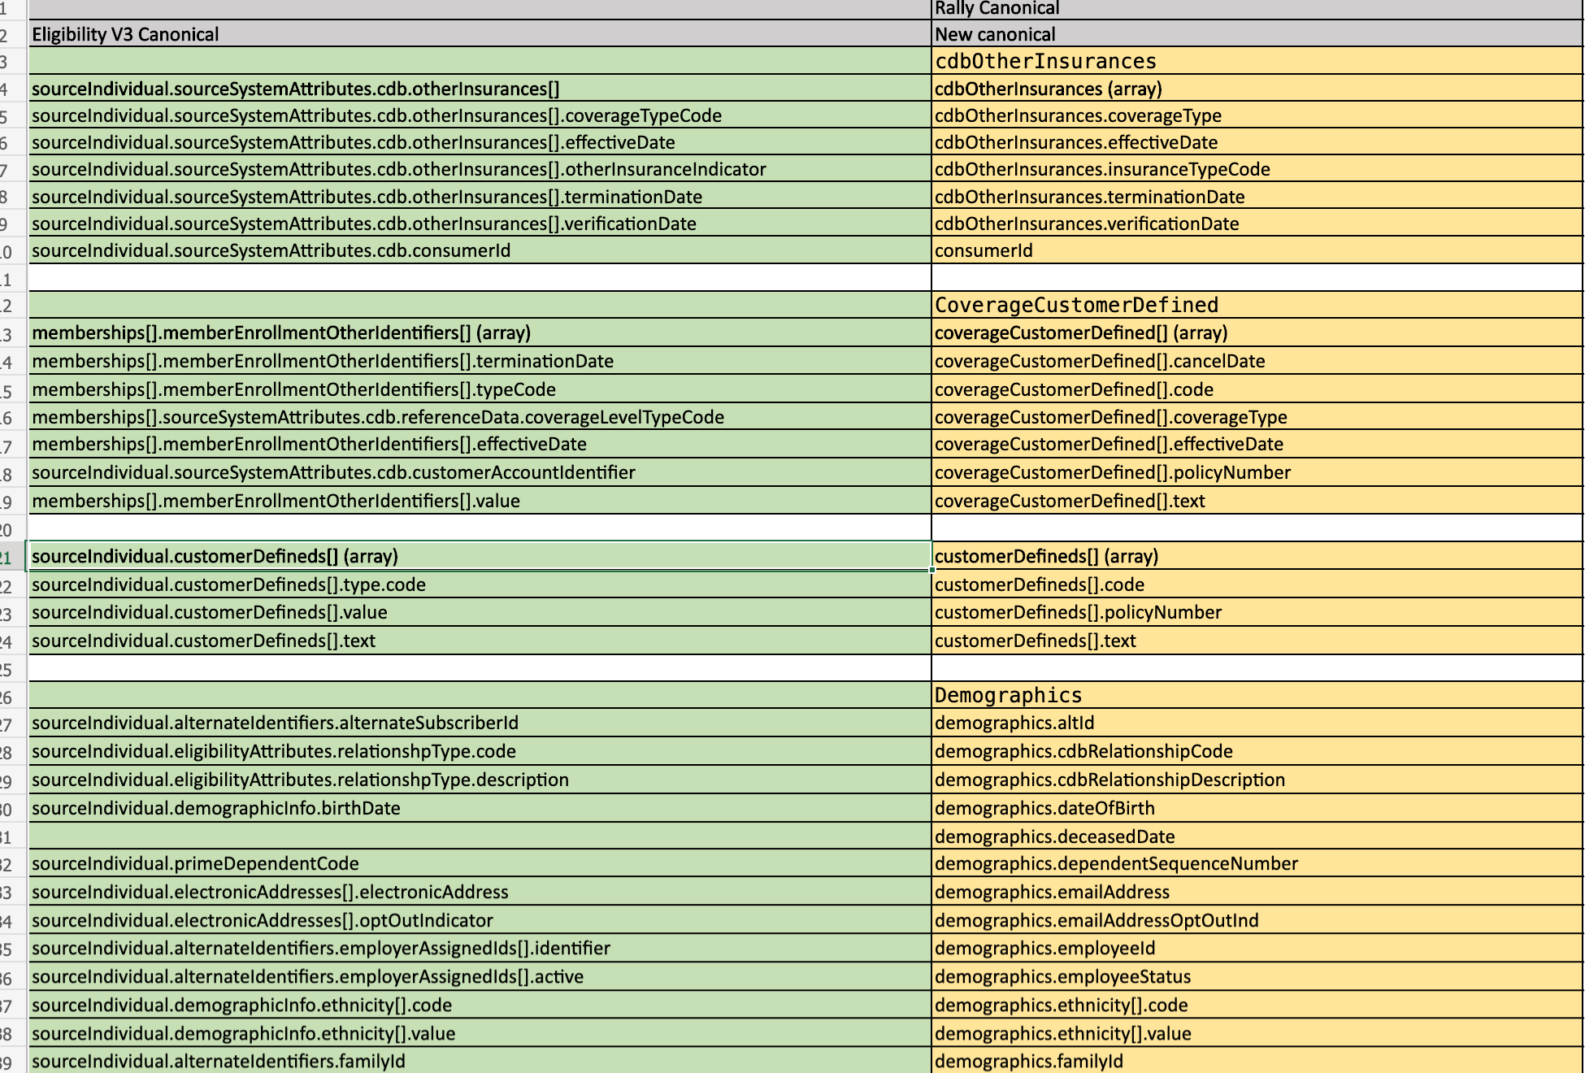
V3 vs V2
Notes:
Mason
There are around 130 fields that we need to map. So, when Rally Health want to access any information, they can access it the same way that they have been with the V2. But now, since they are mapped to the V3 canonicals, they wont even know that they are using the new system. This makes a smooth transition for Rally Health and utilizes the new V3 system. So far, we are working on mapping the first five fields, and once we have the mapping logic down, we can map all 130.

Slide 6
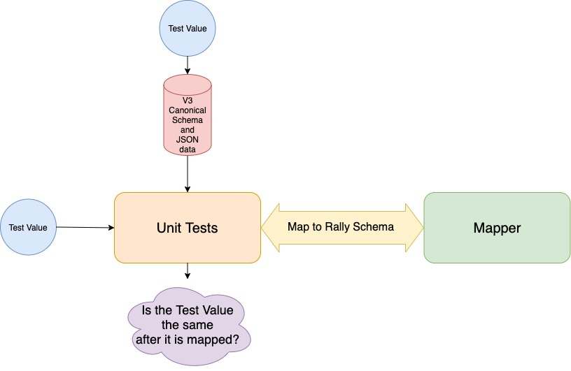
1st type of testing: The Unit Test
Notes:
Mason
The unit test tests the values that are currently in question. So, you input a value and it gets mapped from the V3 schema to the V2. Then, it compares the value from where it should be mapped to and compares it to the unmapped value to make sure that they are the same. The unit tests will be used to make sure mapped values are correct before we move on to the test harness. We are currently working on writing unit tests for our first 5 mapped values.

Slide 7
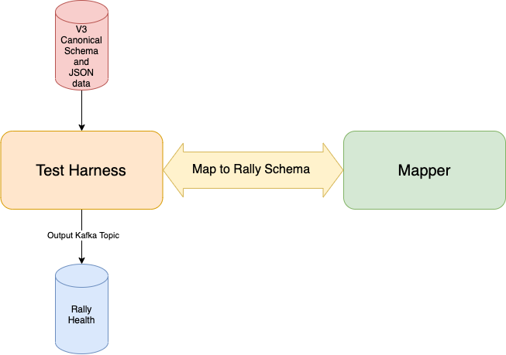
2nd type of testing: The Test Harness
Notes:
Mason
The test harness is used after the unit tests and consists of a few more things. The test harness tests all of the values in the V3 schema.

Slide 8
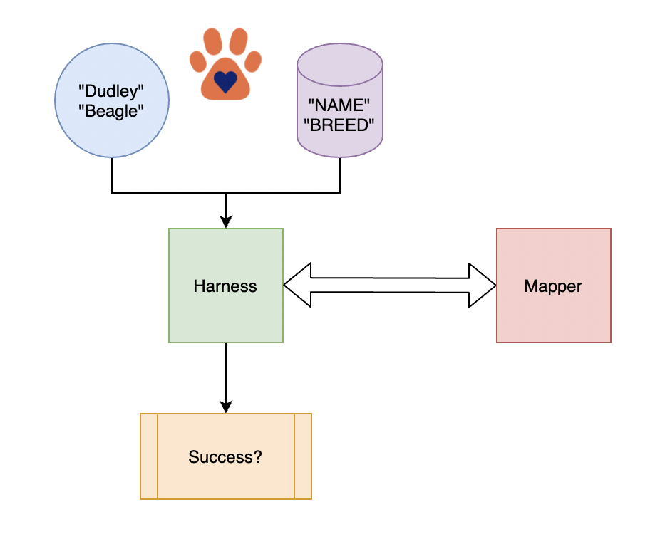

Prototype
Notes:
Naren
Lab is essentially a prototype of solution
An example of how the solution works:
-We essentially created a prototype of our solution by creating a smaller scale mapper and test harness
-We produced a simple mapping of animals/breeds and their names.
-We built a mapper container that transforms a raw pet data message to canonical form.
-Then we created our test harness to pass in a raw pet data record and validate that a canonical pet is published with all the expected fields accurately set.
-Relates to our overall problem because we are essentially doing the same thing, but at a larger scale. Instead of pet data, we will be mapping the v3 schema to the rally health schema. Our test harness will be validating that the newly mapped fields match what is expected.

Slide 9

Challenges
Unit Testing
Canonicals
Creating the specific tests
Creating helper functions and files for the tests
String Union
Name spaces
Notes:
Naren
Unit Testing:
-We had issues creating the specific tests along with creating the helper functions and files for the tests.
-We had some issues with getting our tests, specifically the test that tested the value mapping (which is the more important feature) because it we were still understanding how the V3 input data was used in the test.
-This led to our other big challenge…
Canonicals (more on next slide):
-In order to do our unit tests, we need a proper v3 input canonical.
-This caused issues for us because we were not able to get our test input json file to match our v3 schema.
-We kept getting errors regarding name spaces that we struggled to find and fix because the files were over 2500 lines of json
-We also encountered issues because we had to treat string data as a string union, which allows the data to either be a string or Null.

Slide 10
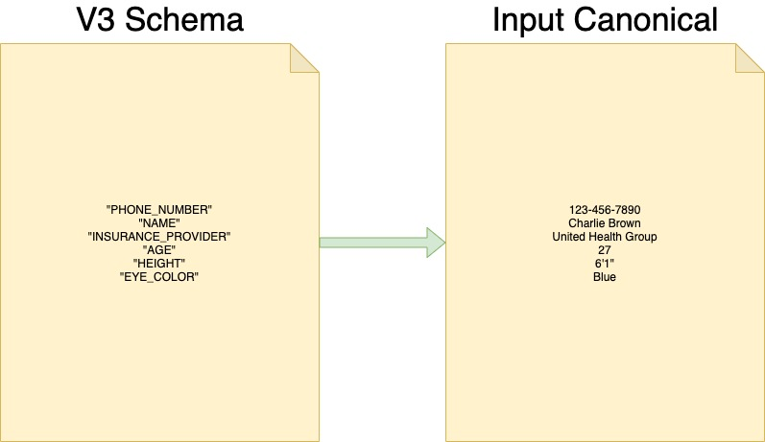
Current Challenge: How is information populated?
Notes:
Naren
Creating an input canonical that will work with our v3 schema.
The input canonical fills in the data in the V3 schema.
We have to make it so it matches the type of data that is supposed to be filled in. Once we have this input canonical finished, we can use it with our unit tests and with the test harness.
So you can see we have to be careful to fill in the information
We also encountered issues because we had to treat string data as a string union, which allows the data to either be a string or Null.

Slide 11
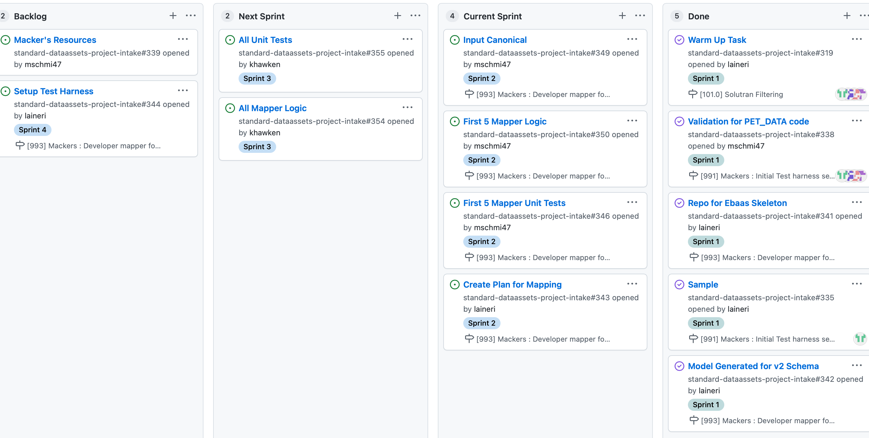
Next Steps
Notes:
Kristen
This is our Kanban board, as you can see we are currently working on implementing mapper logic and unit tests for the first 5 fields. Also, we are formatting the input canonical to be able to put in values. Finally, we are going to create a plan for mapping and a way to split up all 130ish fields among us four. In our next sprint, we will all do the mapper logic and unit tests for our respective sections. Eventually, we will set up the test harness, and create more specific tasks to go with that.

Slide 12
Conclusion
Our Goal
What We’ve Done
Challenges
Next Steps
Notes:
Kristen
-Create a seamless transition from V2 to V3 for Rally Health
-Started our mapping logic and testing that logic for the first 5 fields, created template to input test values
-Challenges with matching up V3 schema and input file and creating corresponding unit tests
-Refining what we've done so far in terms of mapping logic and tests in order to apply it to all 130 fields

